Slide 1
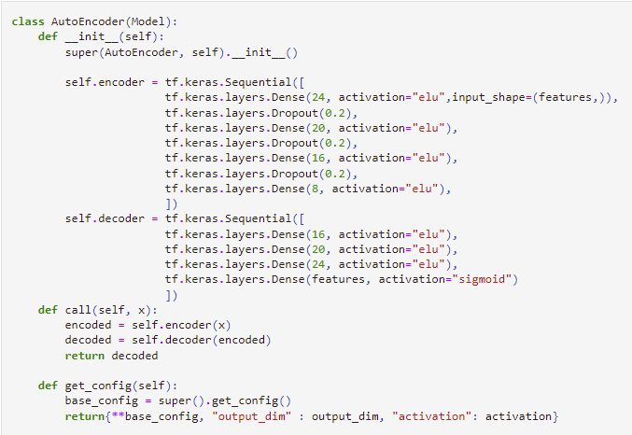
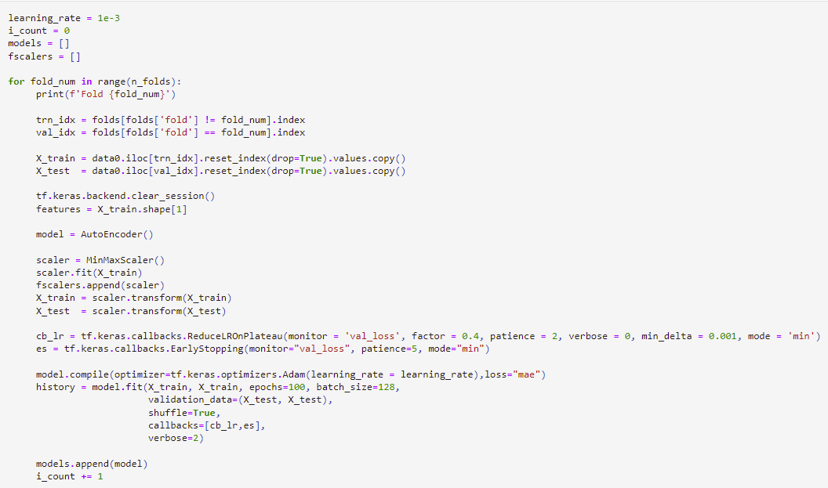
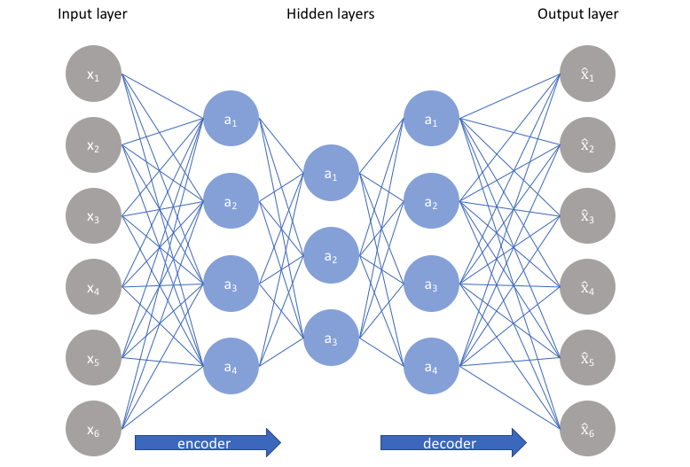
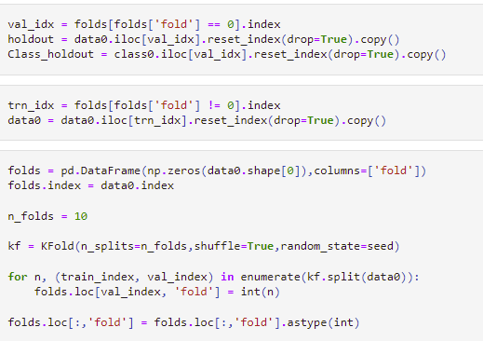
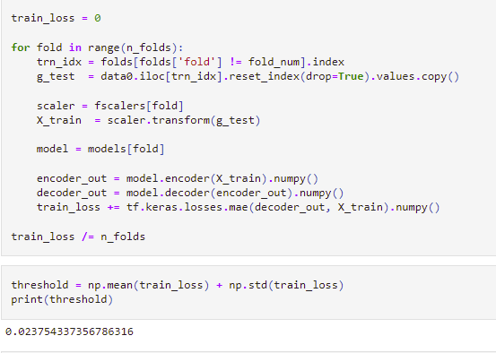
Autoencoder: Anomaly Detection Model Description and Important Code Snippets
Class definition
Main Loop
Neural network architecture such that the bottleneck in the network forces a compressed knowledge representation of the original input
Holdout
Data
Threshold
Calculation
Folds
Calculation
https://github.com/zSoftwareRepository/MDS-561-46-22SU/blob/main/Autoencoder_cv_version2.ipynb

Slide 2
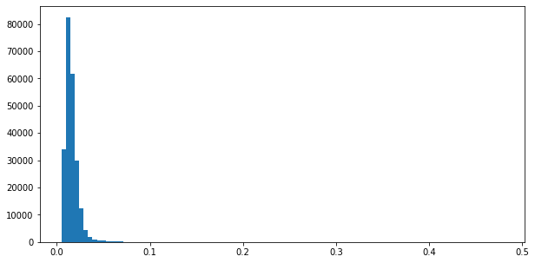
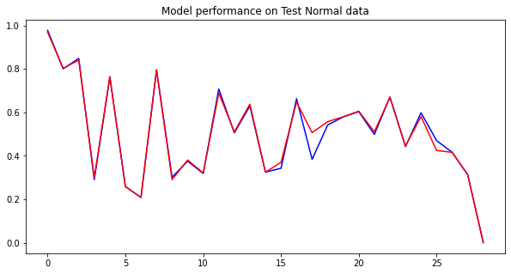
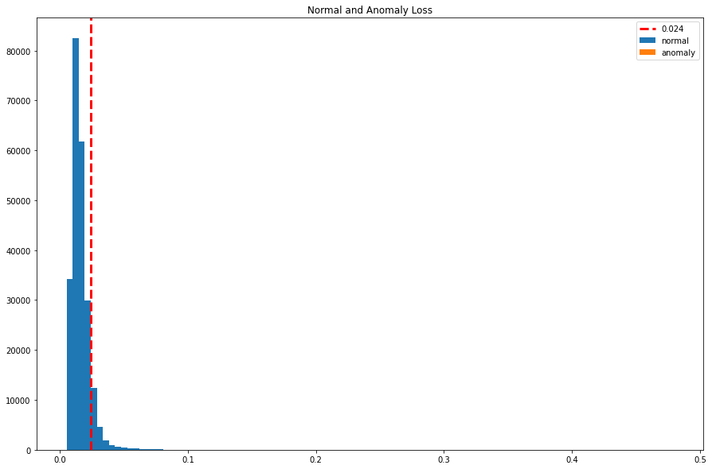
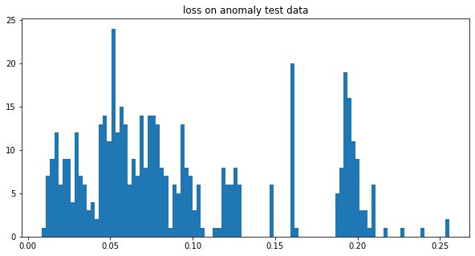
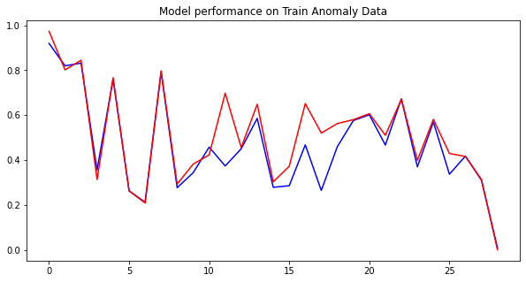
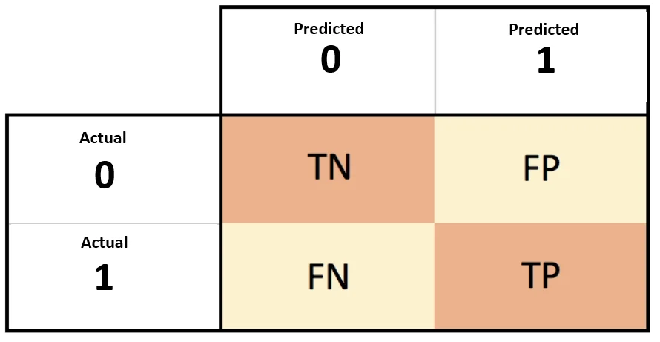
Autoencoder Anomaly Detection Model A Results
Loss on normal data
Threshold: 0.024
Accuracy: 94.29%
Sensitivity: 89.02%
Specificity: 94.47%
26860
TN
1572
FP
108
FN
876
TP

